Slide 1
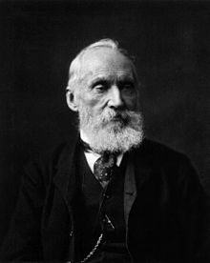
PHYS 2210
Lecture # 14
Vern Hart PhD
vhart@uvu.edu
“How small are atoms? Suppose that you could mark the molecules in a glass of water, then pour the contents of the glass into the ocean and stir the latter thoroughly so as to distribute the marked molecules uniformly throughout the seven seas; if you then took a glass of water anywhere out of the ocean, you would find in it about a hundred of your marked molecules.” -Lord Kelvin

Slide 2
Today we are going to learn about:
Θέρμο
“Thermo”

Slide 3
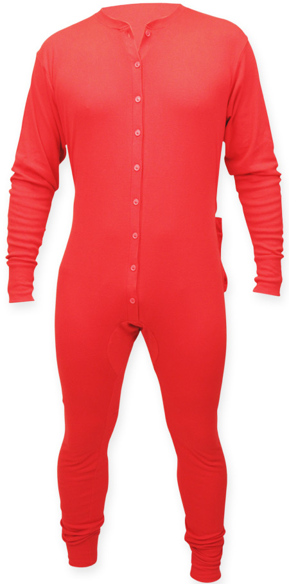
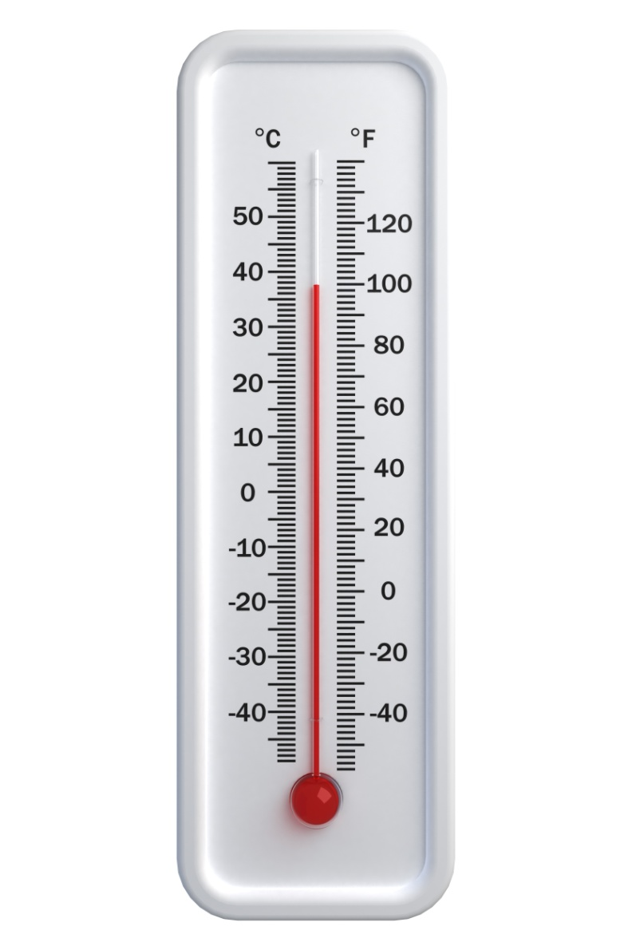
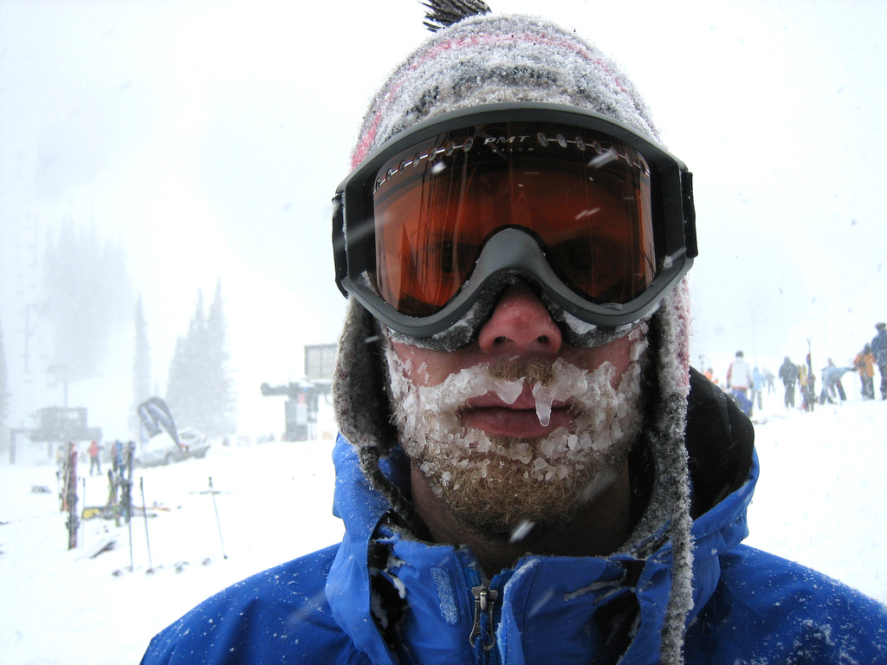
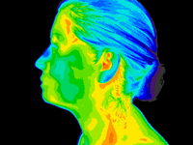
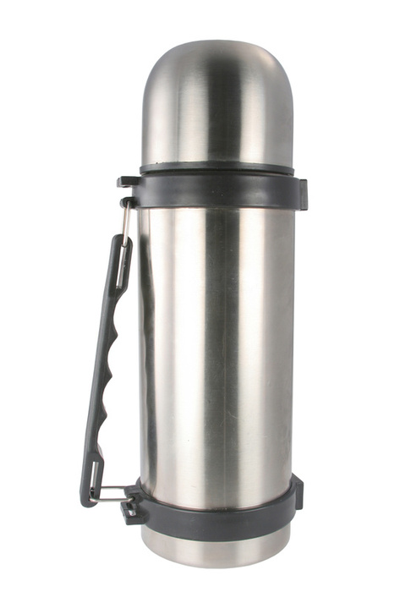
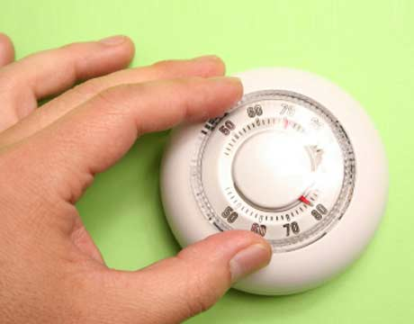
“Thermo”
-Thermos
-Thermostat
-Thermometer
-Thermal underwear
-Thermogram
-Hypothermia

Slide 4
“Thermo” means…
Heat

Slide 5
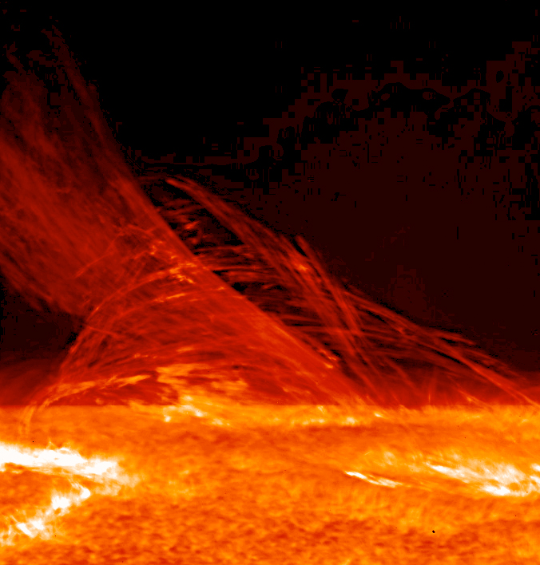
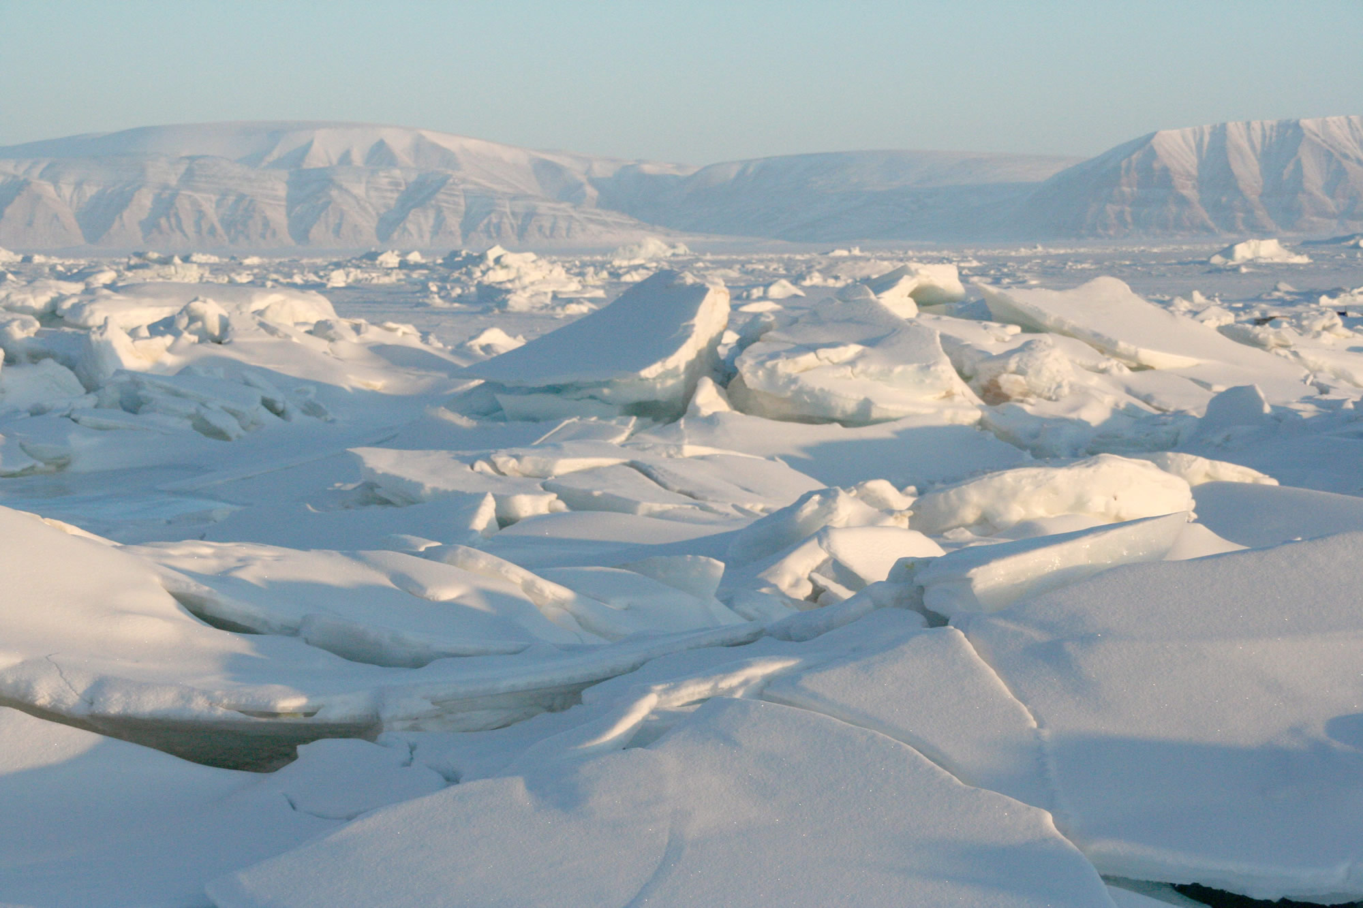
What is heat?

Slide 6
How do we define hot and cold?
Temperature

Slide 7
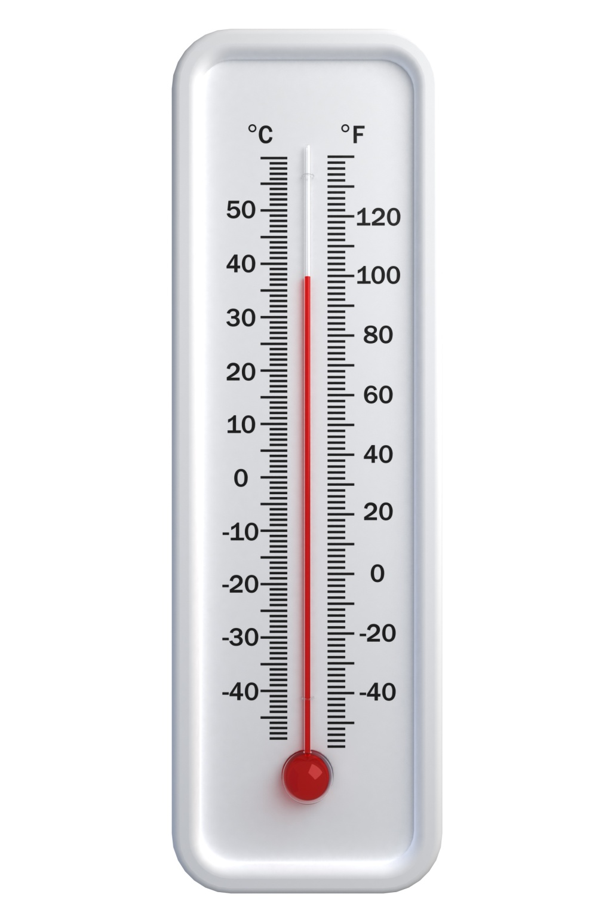
What does temperature measure?

Slide 8
The blasted, cursed, box problem!
F_{A} =200 N F_{f} =50 N D=10 m
Where did the rest of the energy go?
F_{f}
F_{A}

Slide 9
Energy Conservation
PE+KE=PE+KE
How big is our system?

Slide 10
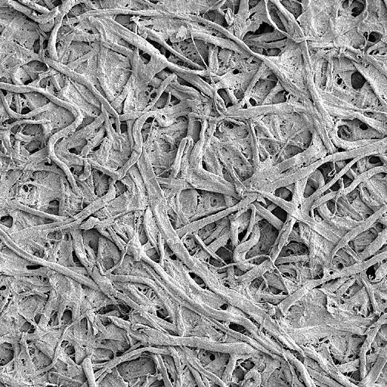
Does the floor have kinetic or potential energy?
Paper

Slide 11
Friction induces molecular vibrations
Vibrations give molecules energy

Slide 12
What kind of energy?

Slide 13
Elastic Potential Energy
An atomic workout video?

Slide 14
Rotational Kinetic Energy

Slide 15
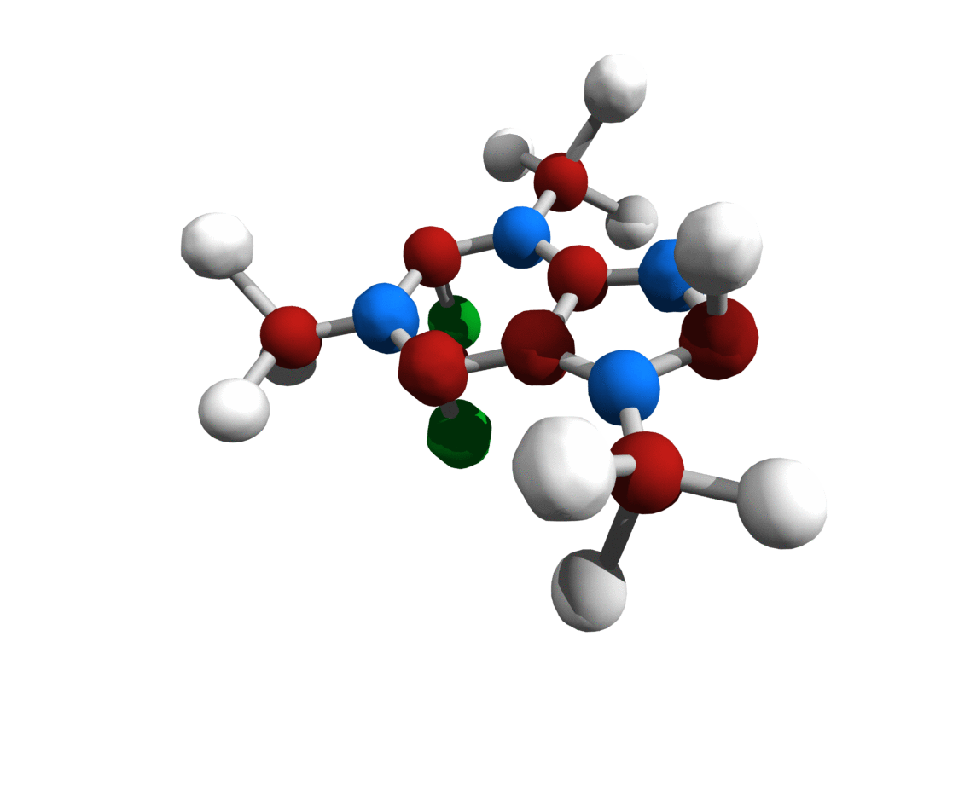
Translational Kinetic Energy

Slide 16
Total Internal Energy
E_{int} = E_{vib} + E_{rot} + E_{kin}

Slide 17
What is temperature?
The average internal energy of particles in a material

Slide 18
Question:
Why do we use the term average?

Slide 19
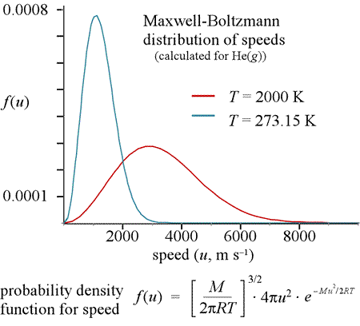

Slide 20
What is heat?
The transfer of thermal energy between objects

Slide 21
Heat = Energy
Seriously, it is measured in Joules
Energy is everything!

Slide 22
Question:
What happens to the temperature of an object when I apply heat?
Answer:
It goes up (duh, darn you Dr. ♥ and your rhetorical questions)
By how much?

Slide 23

It depends on the…
Heat Capacity
Q=C∆T

Slide 24

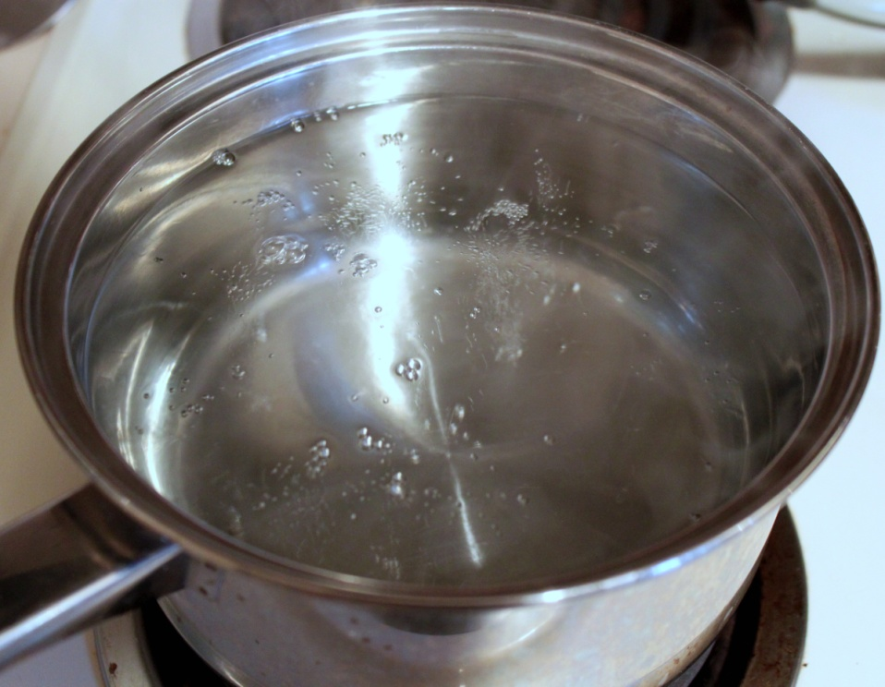

Question
Shouldn’t the temperature change depend on the mass of the object?

Slide 25
Yes, that’s why they invented the…
Specific Heat Capacity
C=mc
Q=mc∆T

Slide 26
The heat transfer equation
Q=mc∆T

Slide 27
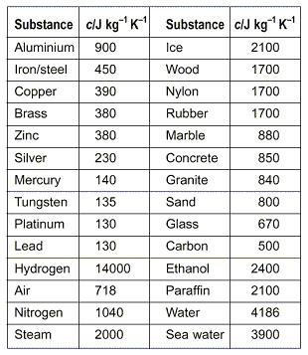

Slide 28
Practice Time
How much energy is required to heat a 4kg chunk of lead from 200K to 300K?

Slide 29
Suppose you are trying to boil 4kg of water to make macaroni and cheese (your dietary staple). The burner elements supply 300 W of power to the pan. For simplicity, assume that all of the energy goes into the water (not true). If the water started out at a temperature of 300K, how hot will it be after 300 seconds (5 minutes)?

Slide 30
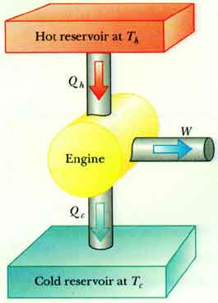
Remember Energy Conservation
Amount in = Amount out
It all has to go somewhere

Slide 31
Suppose you drop a 2kg piece of hot lead (4000 K) into a swimming pool filled with 2000kg of water at a temperature of 300 K. Find the final temperature of the pool?

